Slide 1


HELP of Southern Nevada
HELPING PEOPLE HELP THEMSELVES

Slide 2
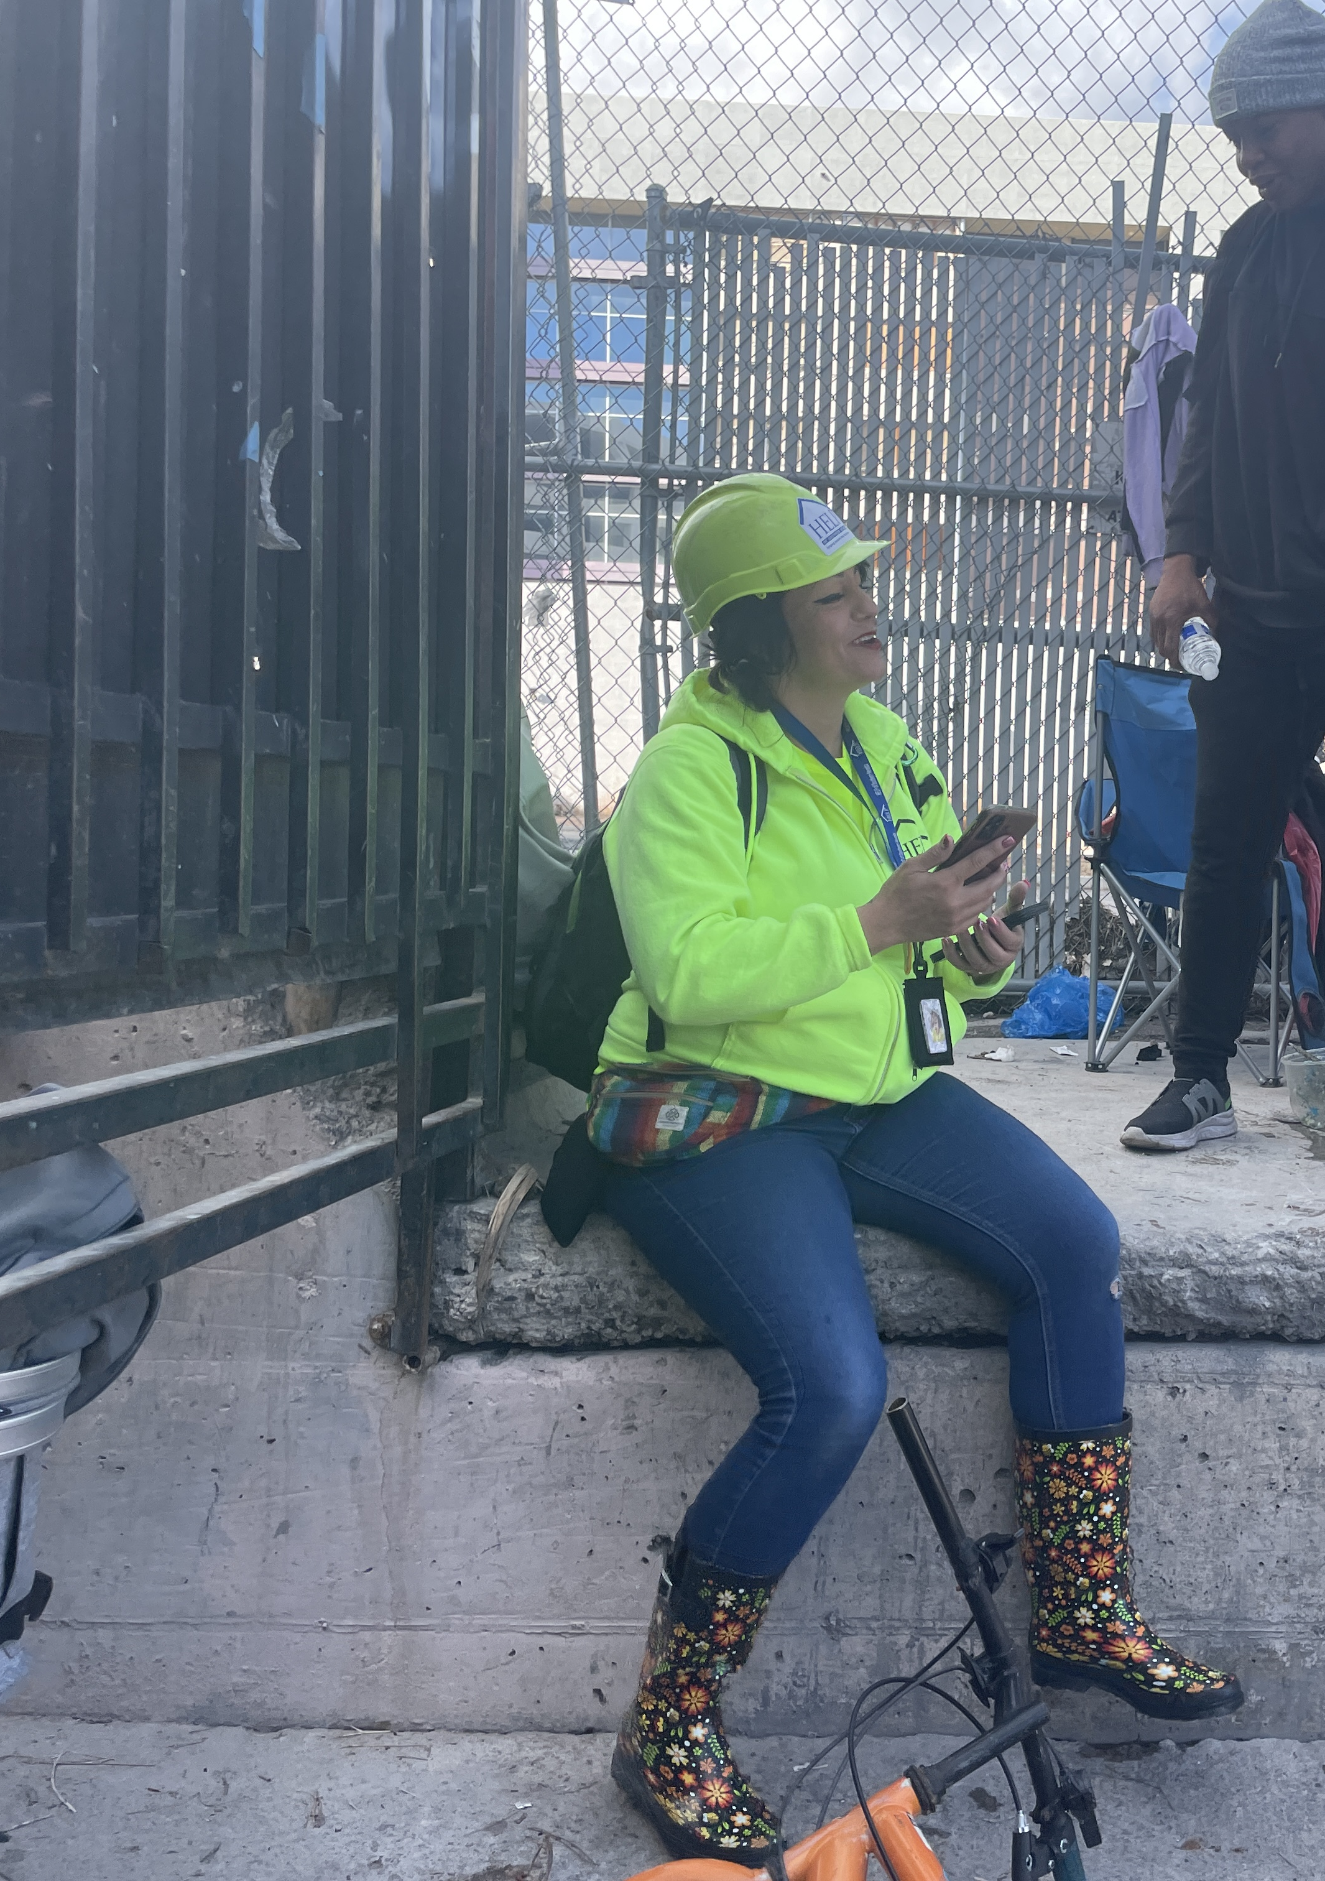
Homeless Response Teams
Conducts outreach at tunnels, washes, vacant lots, abandoned buildings – anywhere people are living in places not meant for human habitation.
Offers shelter, medical, mental health, and substance use referral, as well as completing housing assessments and providing ID assistance.
Works with people where they are – no requirements to enter treatment or other criteria.
Connected over 2,083 people to emergency shelter last year.

Slide 3

Economic Impacts
Only 27% of clients last year reported having any income
  The average income was $1,200.
  56% of clients with income reported the income source was from Social Security.
  Average rental price in Las Vegas is $1,474-1,939 a month.

Slide 4
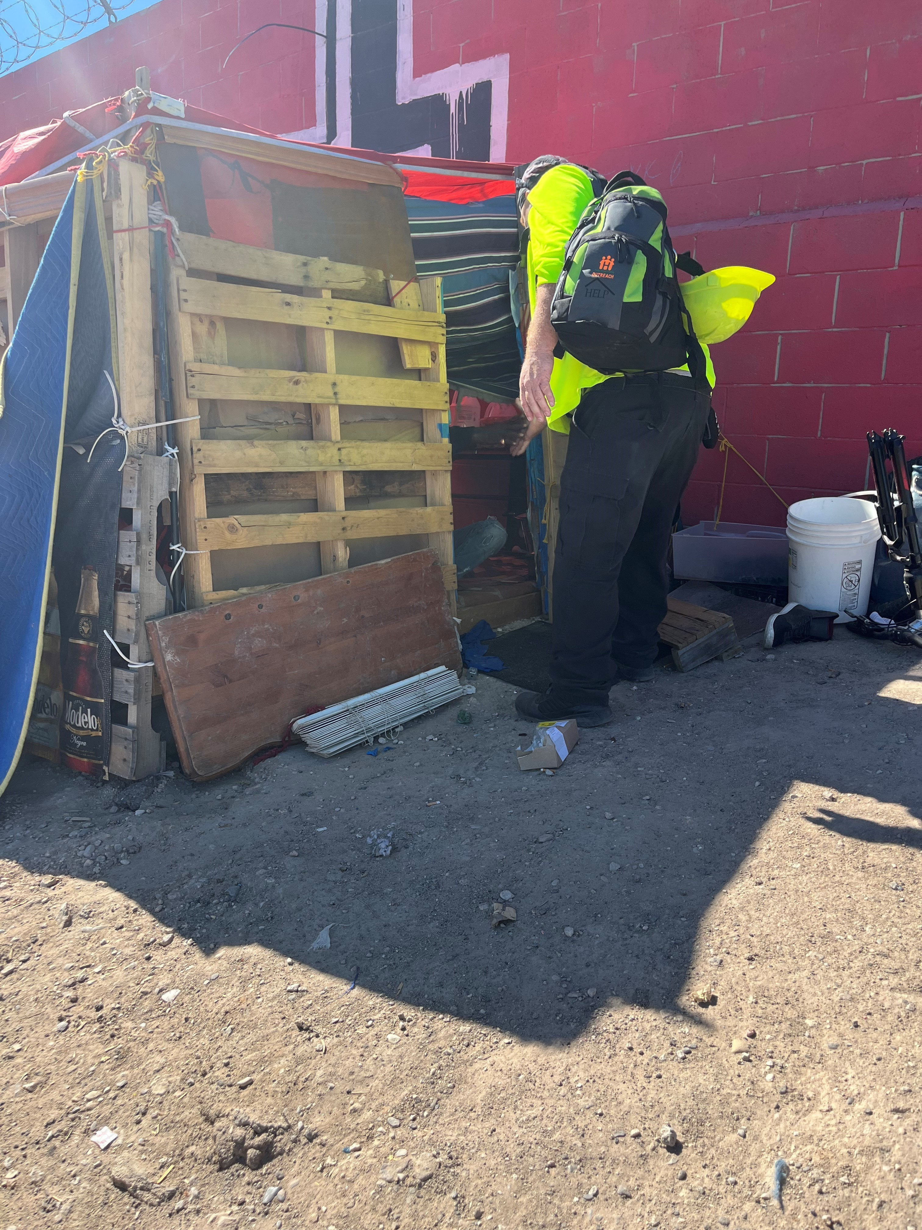
Demographics
Black individuals overrepresented for every jurisdiction in Clark County at rates of 20%-42%
  Rates are highest in North Las Vegas
Disparity caused by a history of discrimination and limited economic opportunities.

Slide 5
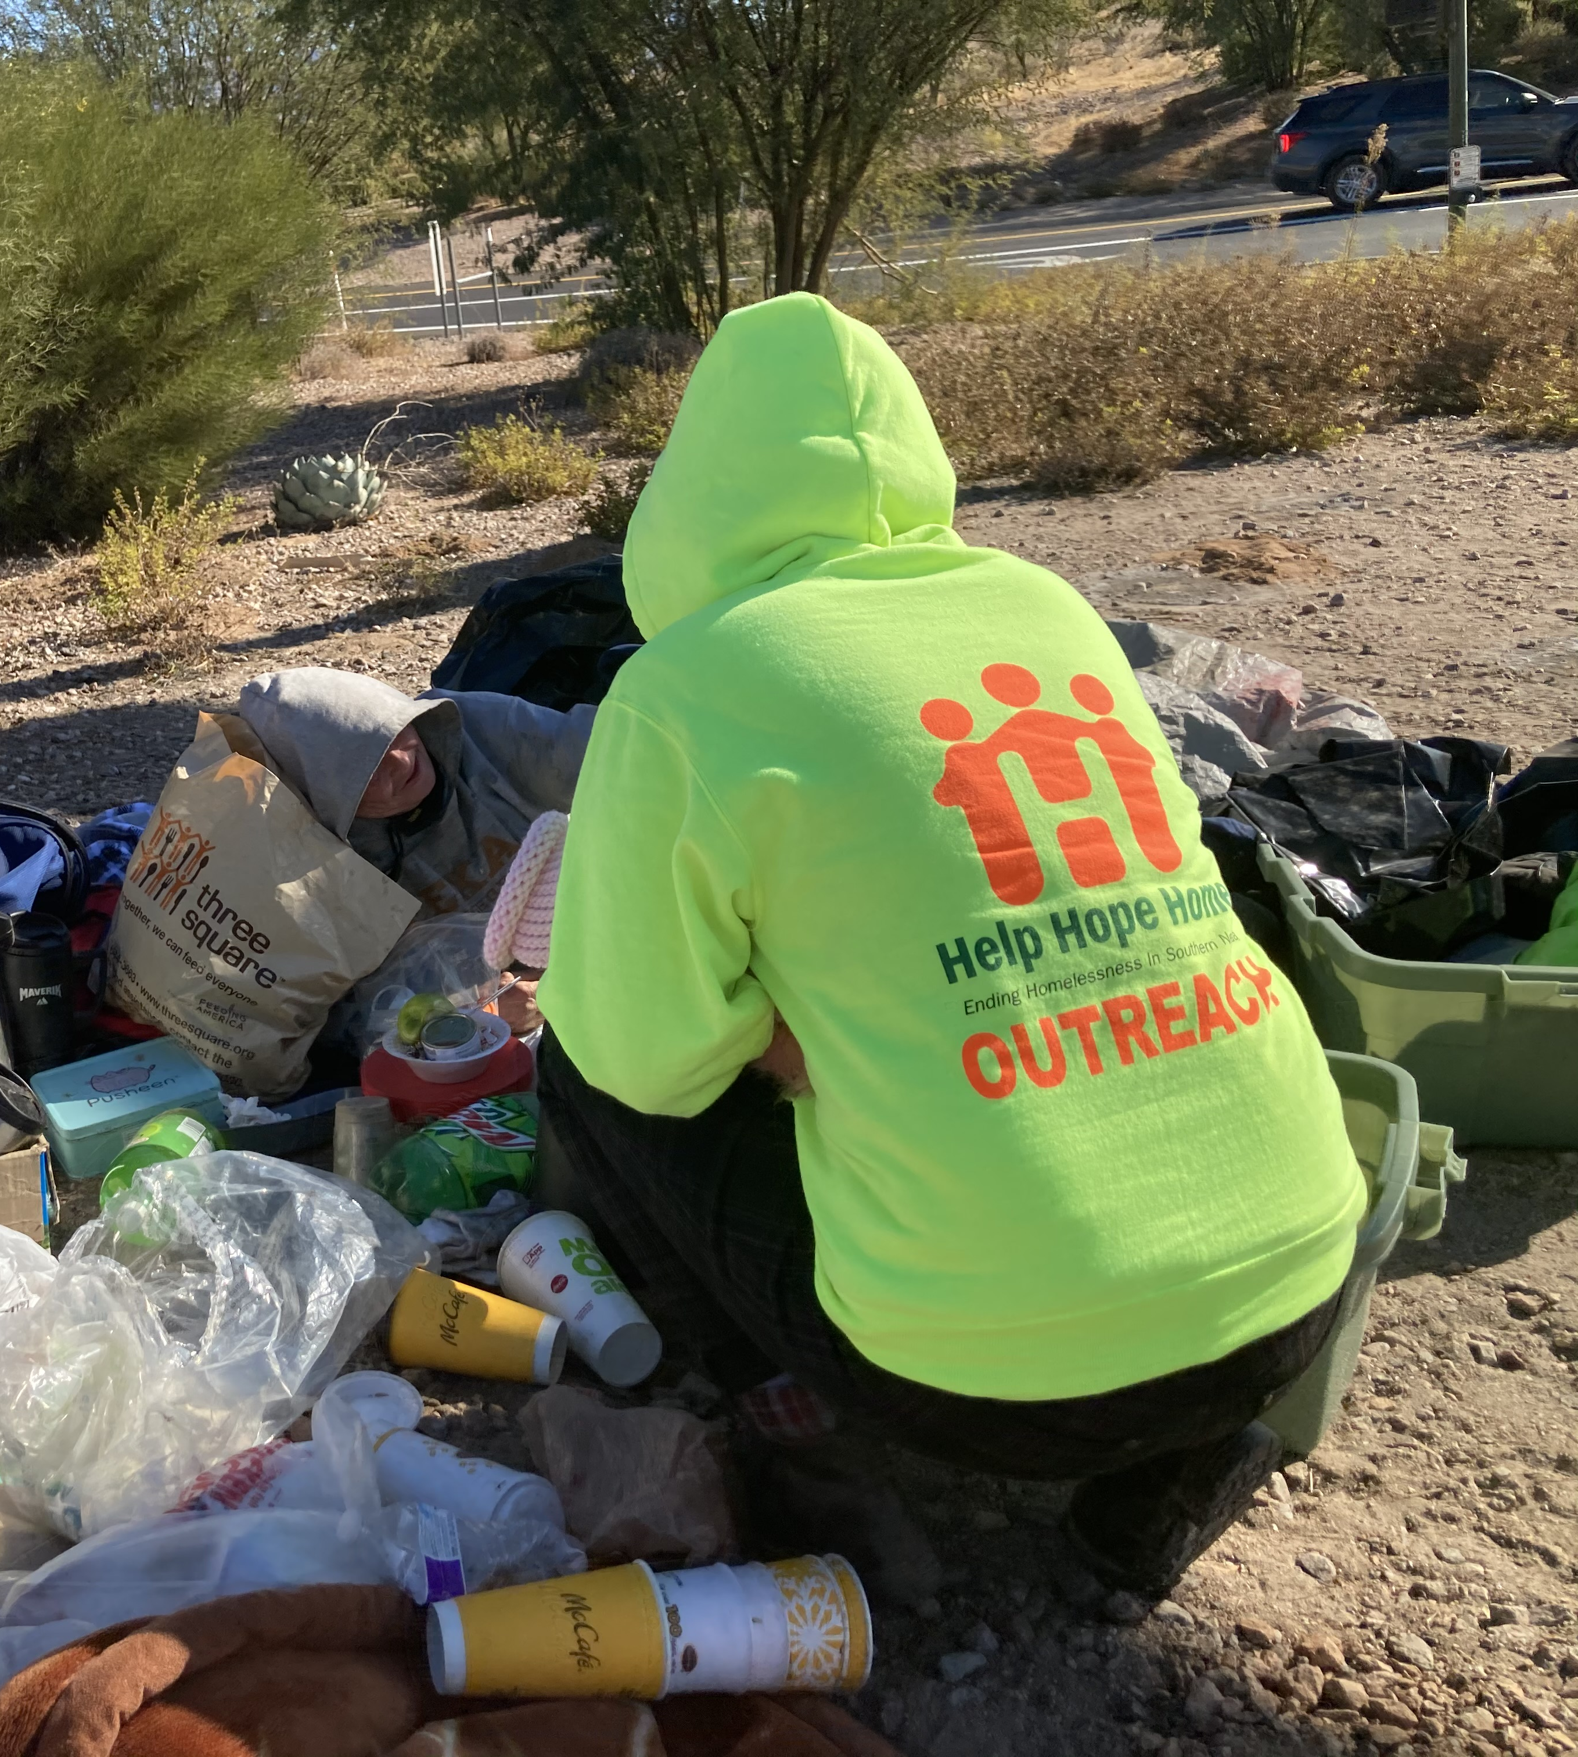
Alyssa Johnson
Louis Lacey
Miguel Rodriguez
HELP of Southern Nevada
702-203-9867
ajohnson@helpsonv.org
702-813-7273
llacey@helpsonv.org
702-683-5790
mrodriguez@helpsonv.org

